Slide 1
Mobile Application Development
Activity Lifecycle
Fragments

Slide 2
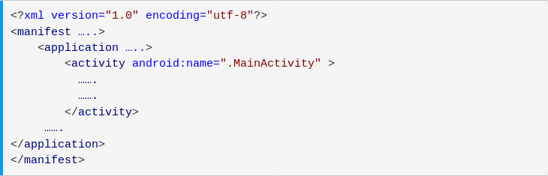
Activity Life Cycle
Activity represents a single screen of Android app’s user interface
Android activity is very similar to windows in a desktop application.
Each android activity must be registered in AndroidManifest.xml

Slide 3
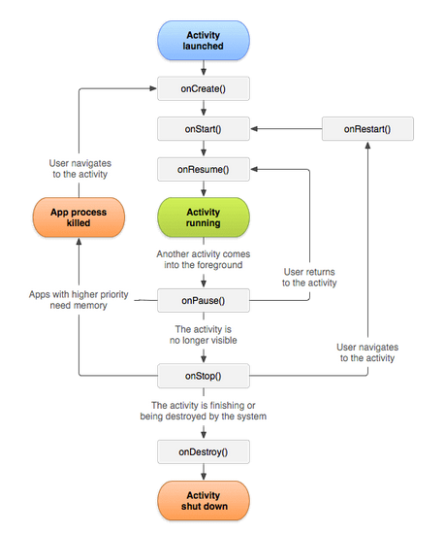

Slide 4
Activity Life Cycle
onCreate()
onStart()
onPause()
onRestart()
onResume()
onStop()
onDestroy()

Slide 5
onCreate()
This is the first call back method
It fires when the system creates an activity for the first time.
If we have application startup logic that needs to perform only once during the life cycle, we can write that login in onCreate() method.

Slide 6
onStart()
This method is invoked right after the completion of onCreate method
This method makes activity visible to user and execution will be very quick.
@Override
protected void onStart() {
super.onStart();
}

Slide 7
onResume()
Users can start interacting with the app
The app will stays in this Resumed state until an another activity happens to take focus away from the app like getting a phone call or screen turned off, etc.
In case if any interruption events happen in Resumed state, the activity will entered into Paused state and the system will invoke onPause() method.

Slide 8
onPause()
Whenever the user leaves an activity or the current activity is being Paused then the system invoke onPause() method.
The onPause() method is used to pause an operations like stop playing the music when the activity is in paused state or pass an activity while switching from one app to another app because every time only one app can be focused.

Slide 9
onStop()
The onStop() method is useful to release all the app resources which are no longer needed to the user.
The system will invoke onStop() callback method when an activity no longer visible to the user

Slide 10
onRestart()
The system will invoke onRestart() method when an activity restarting itself after stopping it.
The onRestart() method will restore the state of activity from the time that is being stopped.
The onRestart() callback method in android activity will always followed by onStart() method.

Slide 11
onDestroy()
The system will invoke onDestroy() method before an activity is destroyed and this is the final callback method which received by the android activity.
The system will invoke this onDestory() callback method either the activity is finishing or system destroying the activity to save space.

Slide 12
Fragments
A fragment represents a portion of user interface in a activity.
A fragment must be always hosted in an activity.
Can combine multiple fragments in a single activity.
Fragment’s life cycle is directly affected by the host activity’s.
  E.g.
    When activity is paused, so are all fragments
    When activity is destroyed, so are all fragments
Can manipulate each fragment independently such as add or remove then. (can be called as fragment transaction)
Fragments can be added in back stack that’s managed by activity -each back stack entry in the activity is a record of fragment transaction that occurred.
Back stack allows the user to reverse a fragment transaction by pressing the Back button.

Slide 13
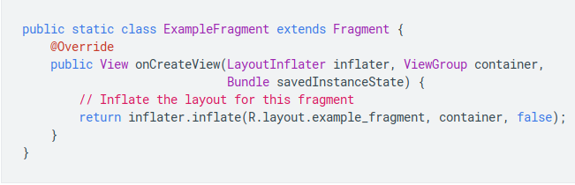
Creating a Fragment
Create a subclass of Fragment.

Slide 14
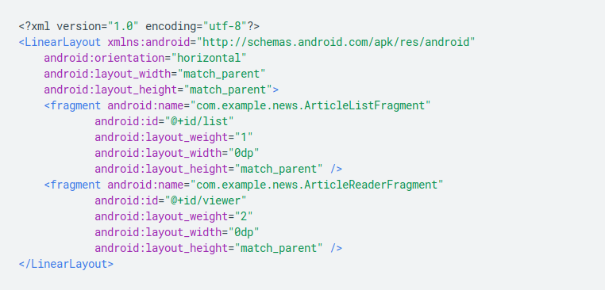
Creating a fragment
Declare the fragment inside the activity’s layout file
Programmatically add fragment to an existing ViewGroup.

Slide 15
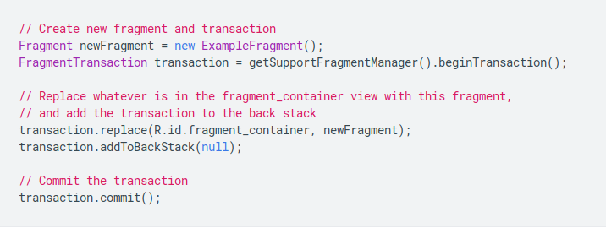
Creating fragment
A ViewGroup is a special view that can contain other views.
The ViewGroup is the base class for layouts and view containers.

